Slide 1

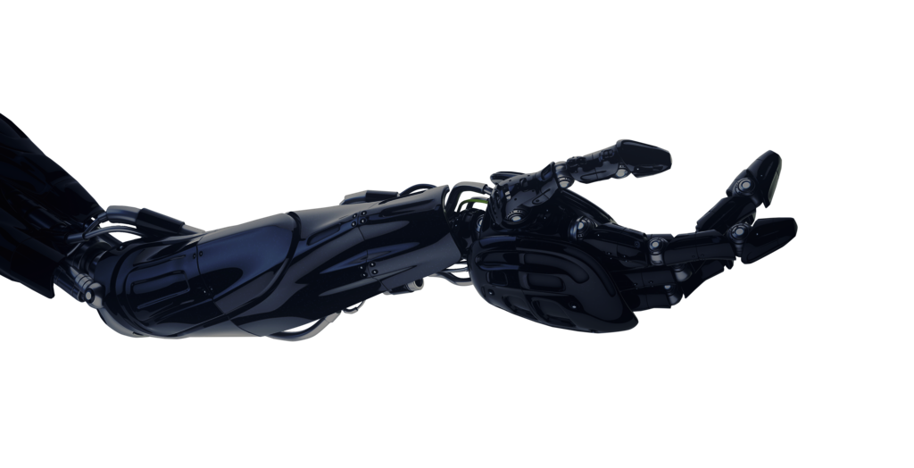
Evolving Sumo Fighting Robots in a Simulated 2D Environment
Jamie Mayer

Slide 2
Introduction
Motivations
Intro to ER
Building a Simulation
Neural Network Controller
Genetic Algorithm
Results
Questions

Slide 3
Motivations
Hand designing robotic controllers becomes increasingly difficult as desired level of complexity increases.
Similar Study conducted by Sharabi and Sipper using GP.
Problems with GP made me want to try with a GA and ANN Controller.
Although ER fell out of favour in the 2000s, it did produce novel solutions so worth revisiting.
Competitive Robotics, E.g.: RoboCup
May provide inexpensive way of developing novel solutions in a hands off manner

Slide 4
Evolutionary Robotics
Uses evolutionary computation to optimise a function, mapping sensor inputs to actuation outputs. Can also evolve robot morphology but not covered in this project.
In early days, controllers would be manually uploaded to physical robot one by one and evaluated for fitness. This was time very time consuming.
Cliff, Harvey & Husbands introduced a method of using an Artificial Neural Network to act as a controller.
They also presented the benefits of using a simulation to evolve agents over real world. Mainly increased time efficiency.
This also has disadvantages when transferred to real world agent. Mainly noise in the real world being difficult to replicate in a simulation.

Slide 5



Building a Simulation
Built using the Pymunk and Pygame libraries for Python
Other options were explored, these appeared most suitable
Pymunk handles physics
Pygame handles graphics
Consists of ‘bots’ and ‘world’ as well as all of the simulation logic.
Was the most time consuming part of the project by a large margin

Slide 6
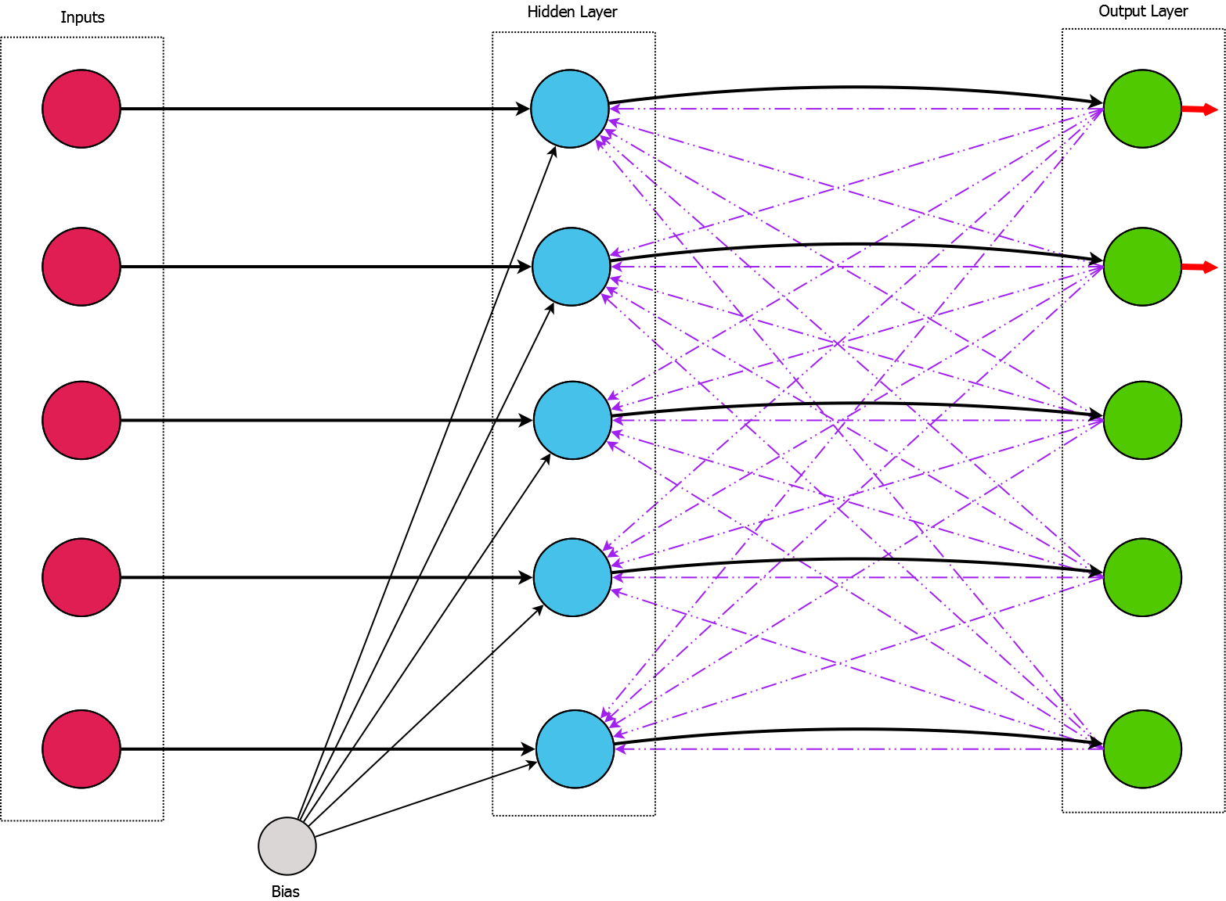

Neural Network Controller
Continuous Time Recurrent Neural Network (CTRNN)
CTRNN is a Dynamical System, adding temporal dynamics that are not present in a standard feed forward MLP/RBF etc.
Also introduces an element of internal memory via recurrent connections.
Retains the property of being a universal function approximator.
$$\frac{dy_{i+1}}{dt}=y_{i}+tanh⁡[\sum{w_{ij}y_{i}+θ+I_{i}}]$$

Slide 7
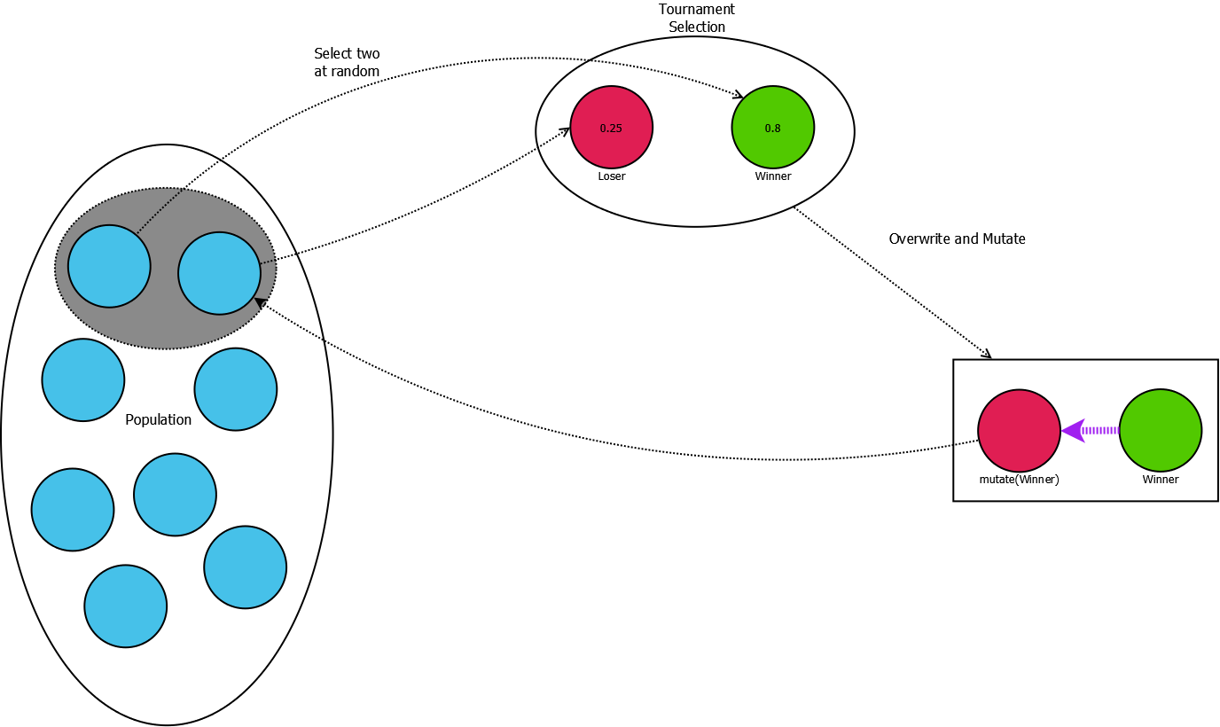
Genetic Algorithm 1
Evolves a single agent to stay within the confines of the sumo arena.
Each population member is ran through the simulation twice, once from each of the starting positions.
Fitness is assessed on mean speed, time spent inside the arena, and a Boolean value representing if the agent stayed inside the arena.
A from of Steady State GA with Microbial crossover.
All genes are copied over and mutated with probability of P=1

Slide 8
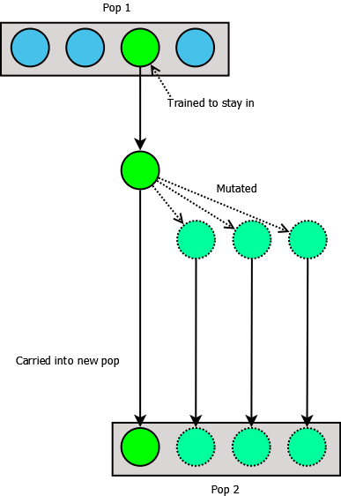
Genetic Algorithm 2
Takes fittest from those evolved to stay inside, mutates them to create a population of size n and evolves them further to compete in a sumo style competition.
2 population members selected at random and placed in simulation. Winner is the one who knocks the other out or stays in the longest.
If a draw, a random winner is picked.
Mutated winner replaces loser in population.

Slide 9
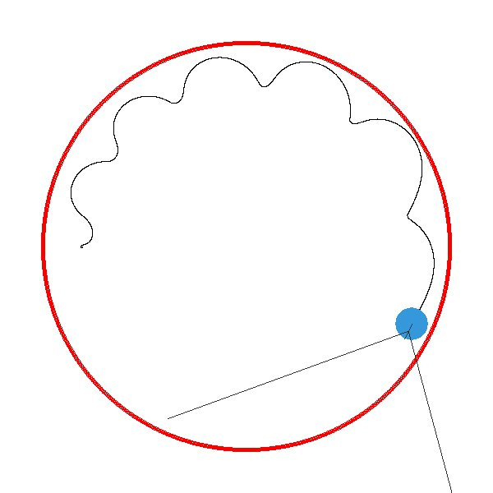
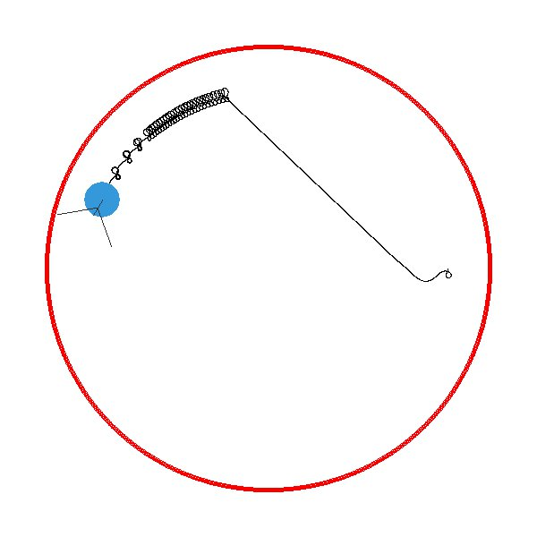
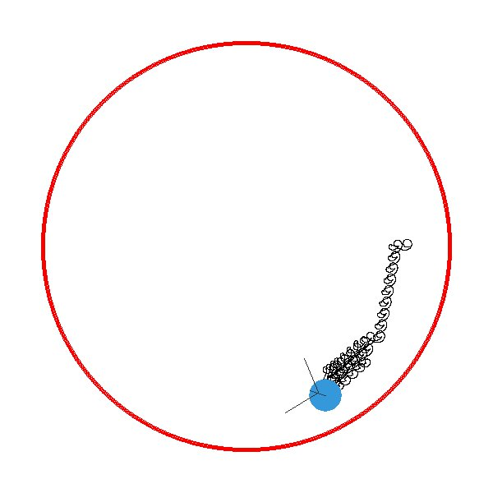
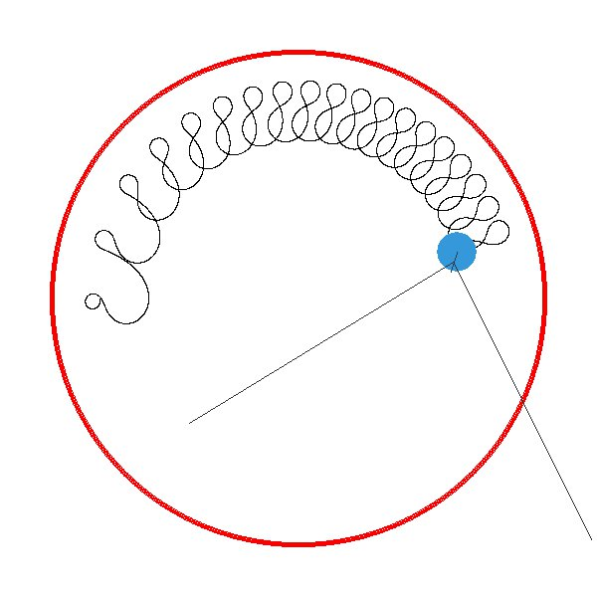
Results 1
A population size of 20, evolved for 40 generations was the best balance between time taken to evolve and fitness reached.
A wide differences in trajectories were discovered upon running multiple times.
An example of an agent that has been evolved to stay within the arena:
https://www.dropbox.com/s/l95wdhav001h3p2/20170328_170106.mp4?dl=0

Slide 10
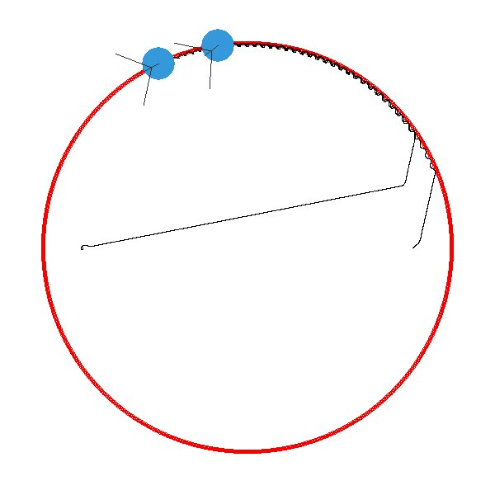
Results 2
By selecting the fittest from one population that has been evolved to stay inside the arena and mutating it to fill the next population (evolved to fight), a lack of diversity was encountered in the gene pool
This caused convergence on local minima
A better solution was to evolve n different populations, taking the fittest from each and forming a new population from those.

Slide 11
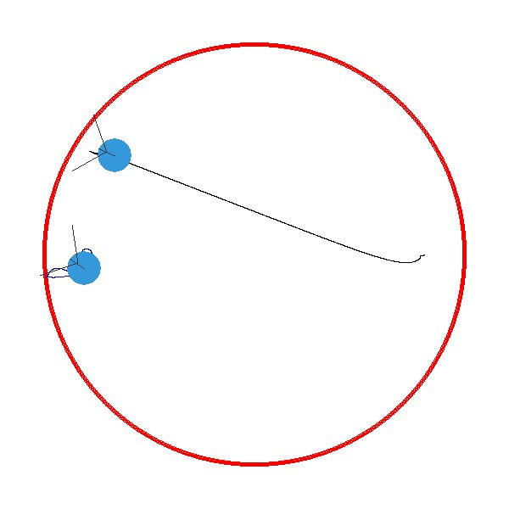
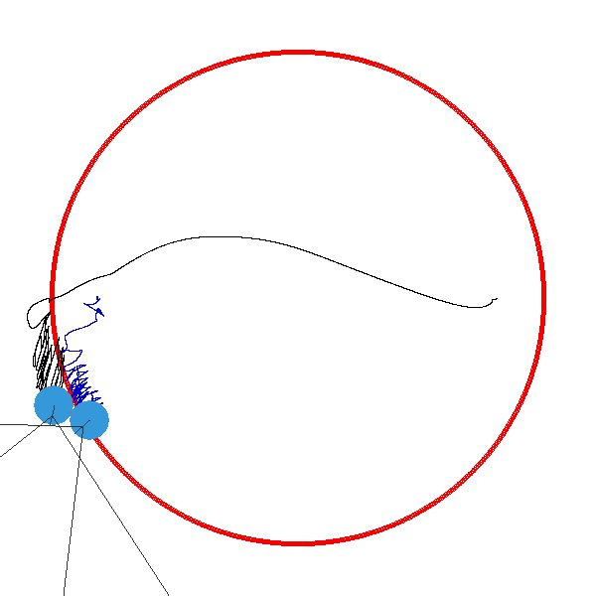
Results 3
It was observed that agents were rarely getting close enough to register each other on their sensors.
When genepool diversified, sensors were also increased in size to see if agents would engage sooner.
This hypothesis appeared to be correct as more complex behaviour was observed when these changes were made.
Two population members before increasing the size of sensors
The same two population members after increasing the size of sensors

Slide 12
Results 4
An interesting observation was that some agents had an excitatory response to sensor signals and others had more inhibitory responses.
Some agents accelerated upon receiving a sensor signal while others slowed down and then accelerated again once the signal subsided.
This resulted in some interesting situations, where inhibitory agents won by defensive measures, some won by offensive measures and even a stalemate
Example of excitatory sensor response:
https://www.dropbox.com/s/64iq77v012civ3l/20170507_233418.mp4?dl=0
Example of stalemate:
https://www.dropbox.com/s/spm4lhgkx0bzy70/20170510_160526.mp4?dl=0
Example of inhibitory/defensive agent:
https://www.dropbox.com/s/5pfsfrr5wtxwawd/20170507_170416.mp4?dl=0

Slide 13
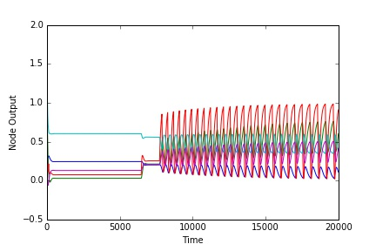
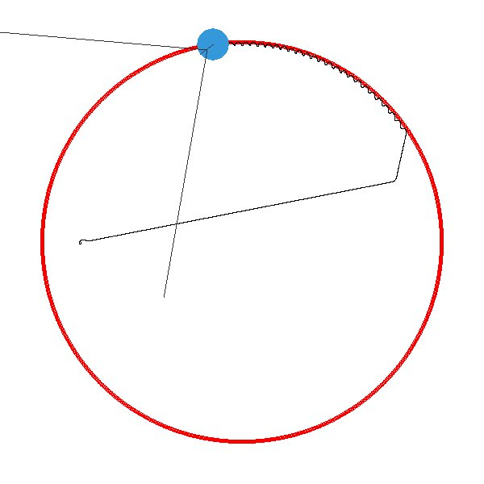
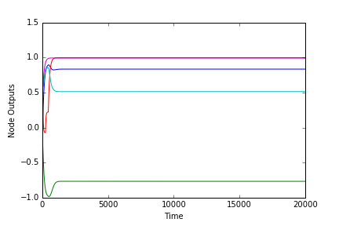
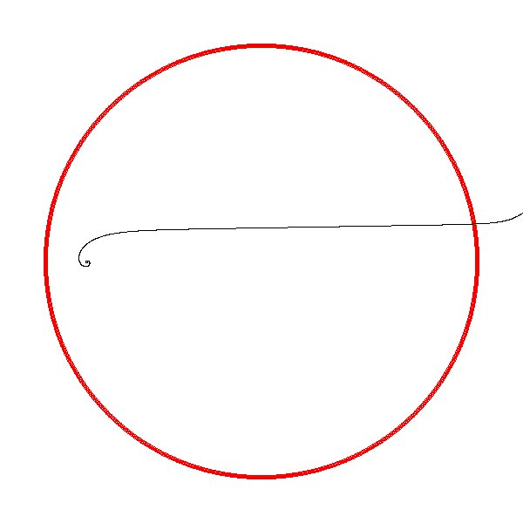
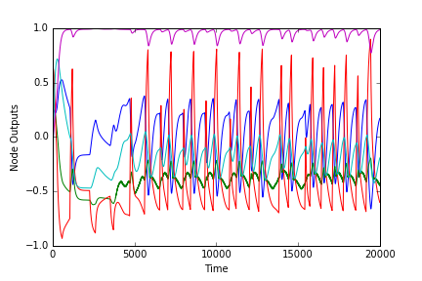
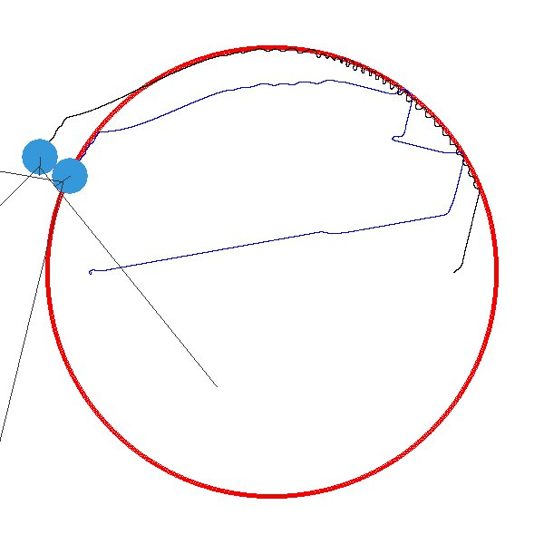
Results 5
Lastly, the robot trajectories were compared with the network outputs over time for the simulation
Agents at three stages of evolution were looked at;
Randomly generated, unevolved agents
Agents evolved to say inside
Agents evolved to fight

Slide 14
Questions?

